Slide 1

HEXBUGS 2.0
Session:
NODE MCU

Slide 2

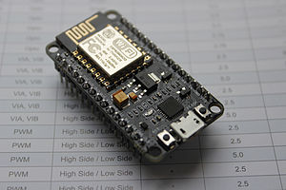
FEATURES
Node MCU is an open source IOT platform.
It runs on the ESP8266 microcontroller, that enables it connect to the internet.
Wifi capability (the antenna)
Memory(RAM) – 32KB
Storage(ROM)-4MB
Processing Speed-2.4ghz

Slide 3
WHY NODE MCU ?
COMPACT SIZE
EASY CONNECTIVITY WITH INTERNET
GREATER MEMORY

Slide 4
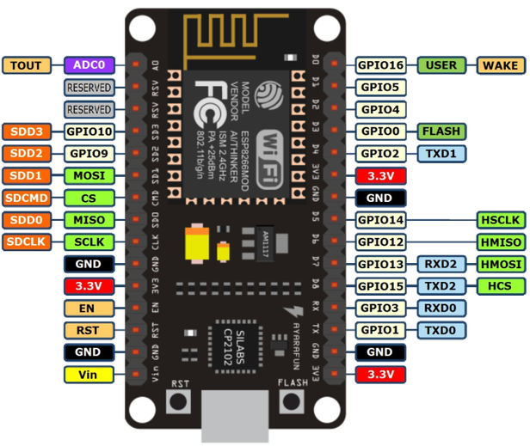
Node mcu architecture

Slide 5
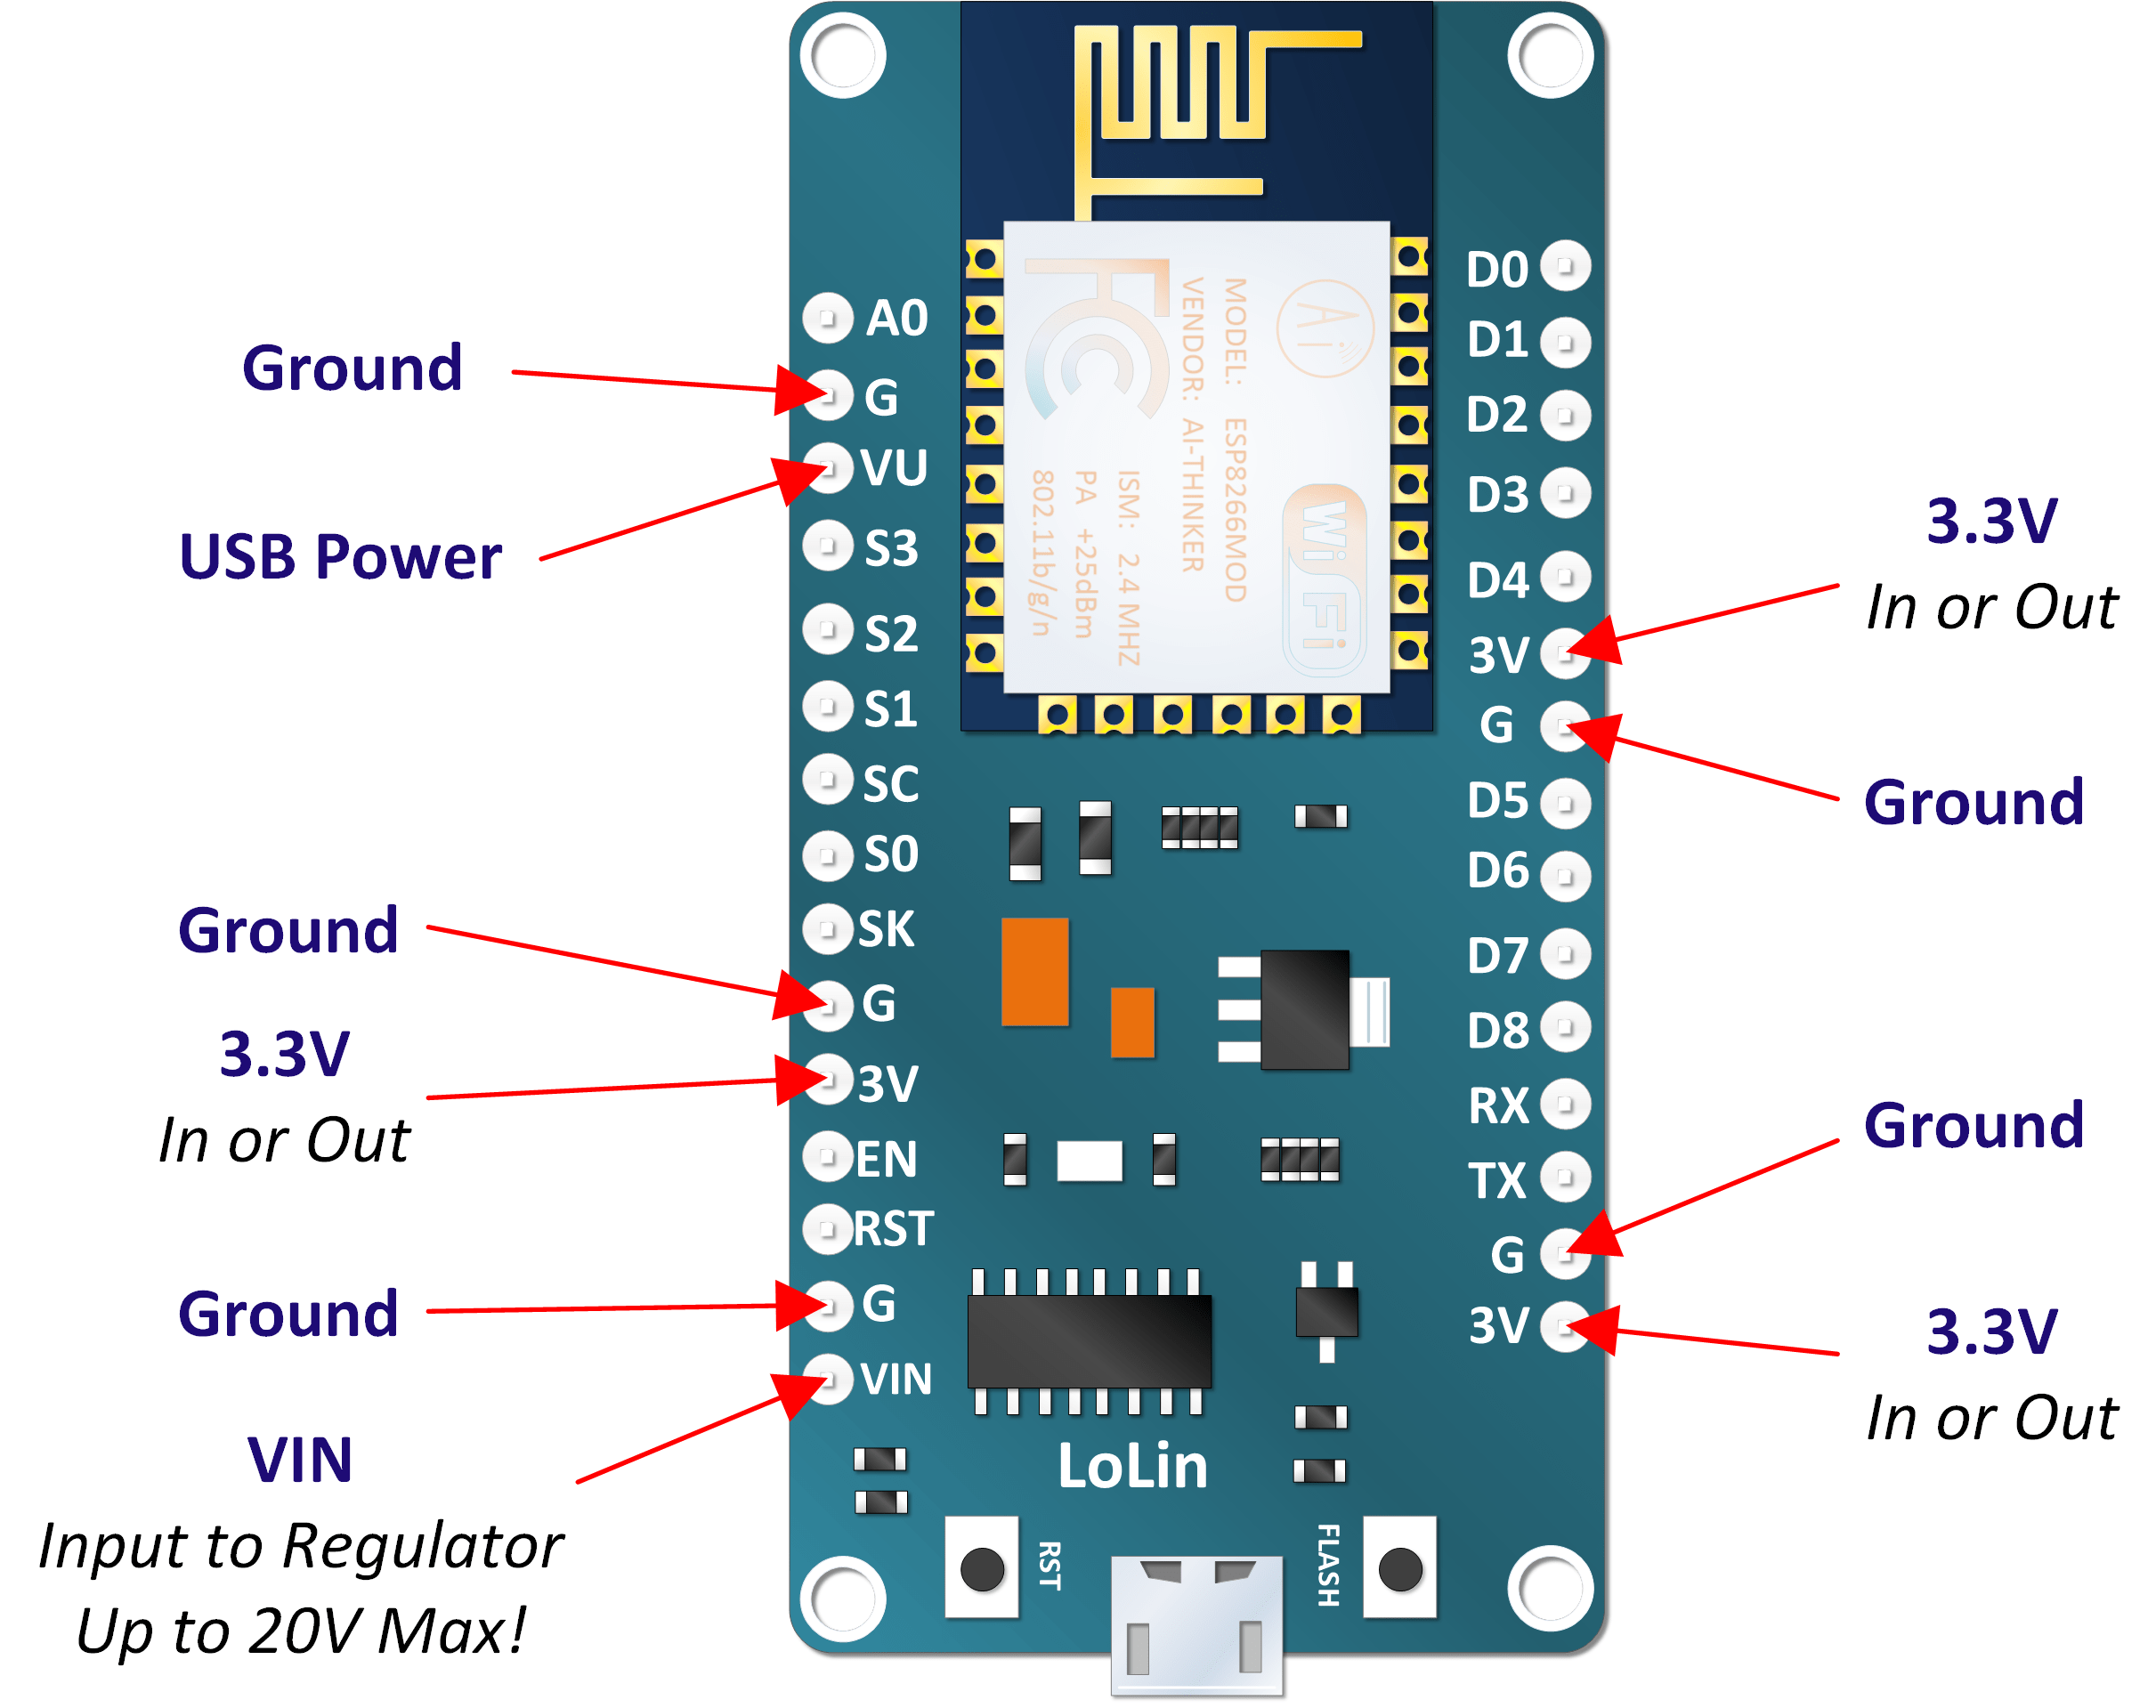
Powering your node mu
Maximum output voltage=3.3V
Max. input voltage=0-20V
4 ground pins , 4 Vcc pins
1 Vin pin to power your node mcu externally
UART- Flash data and communicate serially
2 capacitors to stabilize it

Slide 6
PIN Meanings
3V3-3 Volt Output
GND-Ground
VIN- Input Voltage
TX- Transmission of data
RX- Receiving data
A0- Analog input

Slide 7
NODE MCU AND MOTOR
CONNECTIONS
D5-IN1
D4-IN2
D8-1N3
D7-IN4
ENABLE- VCC

Slide 8
STEPS
Install the board manager
Tools>>Board Manager>>Type 8266
Click Install

